Slide 1
BTC Tweets Sentiment Analysis using NLP

Slide 2
Introduction
Extract tweet related to bit coin
Analyse the dataset
Remove unnecessary information in tweets.
Prepare dataset for the training of the model.
Train the model on bit coin tweets dataset.
Predict the sentiment of bit coin tweets {negative, neutral, positive}

Slide 3
problem statement
Sentiment analysis of bit coin tweets for the classification of sentiment by machine learning and BERT model.

Slide 4
objective
Predict the sentiment of tweet related to bit coin.
Analyse the effect of sentiment of tweet.
Help to predict the price of bit coin in future.
Help the investors to invest in bit coin and sale the bit coin at right time.

Slide 5
reasrch methodology
According to [18] study, The sentiment of a text can be deduced from the words used in the text, sentiment analysis techniques, lexical dictionary of terms, and the polarity of the words. One of the most active fields in NLP is sentiment analysis, sometimes known as opinion mining.

Slide 6

evaluation
Used different evaluation measures to evaluate the performance of the trained models.
Accuracy
Precision
Recall
F1-Score
We calculated the evaluation measures by using the below formulas:
$Accuracy= \frac{TP+TN}{TP+TN+FP+FN}$ Eq. 1
$Precision= \frac{TP}{TP+FP}$ Eq. 2
$Recall= \frac{TP}{TP+FN}$ Eq. 3
$F1 Score= \frac{2∗\left(recall∗Precision\right)}{Recall+Precision}$ Eq. 4

Slide 7
results - Random Forest
 | precision | recall | f1-score | support
Negative | 0.91 | 1.00 | 0.95 | 6623
Neutral | 0.98 | 0.94 | 0.96 | 6857
Positive | 0.99 | 0.82 | 0.90 | 1776
accuracy |  |  | 0.95 | 15256
macro avg | 0.96 | 0.92 | 0.94 | 15256
weighted avg | 0.95 | 0.95 | 0.95 | 15256

Slide 8
Results - Support Vector Machine
 | precision | recall | f1-score | support
Negative | 0.62 | 0.70 | 0.66 | 6623
Neutral | 0.77 | 0.60 | 0.68 | 6857
Positive | 0.39 | 0.54 | 0.45 | 1776
accuracy |  |  | 0.64 | 15256
macro avg | 0.60 | 0.62 | 0.60 | 15256
weighted avg | 0.66 | 0.64 | 0.64 | 15256

Slide 9
Results - KNN Model
 | precision | recall | f1-score | support
Negative | 0.74 | 1.00 | 0.85 | 6623
Neutral | 0.99 | 0.74 | 0.85 | 6857
Positive | 0.98 | 0.71 | 0.83 | 1776
accuracy |  |  | 0.85 | 15256
macro avg | 0.91 | 0.82 | 0.84 | 15256
weighted avg | 0.88 | 0.85 | 0.85 | 15256

Slide 10
Results - BERT Model
 | precision | recall | f1-score | support
Negative | 0.99 | 0.98 | 0.99 | 3290
Neutral | 0.98 | 0.99 | 0.99 | 3441
Positive | 0.97 | 0.96 | 0.96 | 897
accuracy |  |  | 0.85 | 7628
macro avg | 0.91 | 0.82 | 0.84 | 7628
weighted avg | 0.88 | 0.85 | 0.85 | 7628

Slide 11
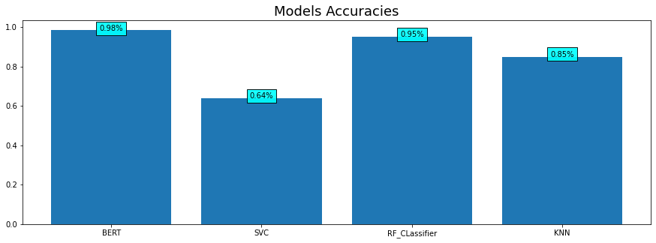
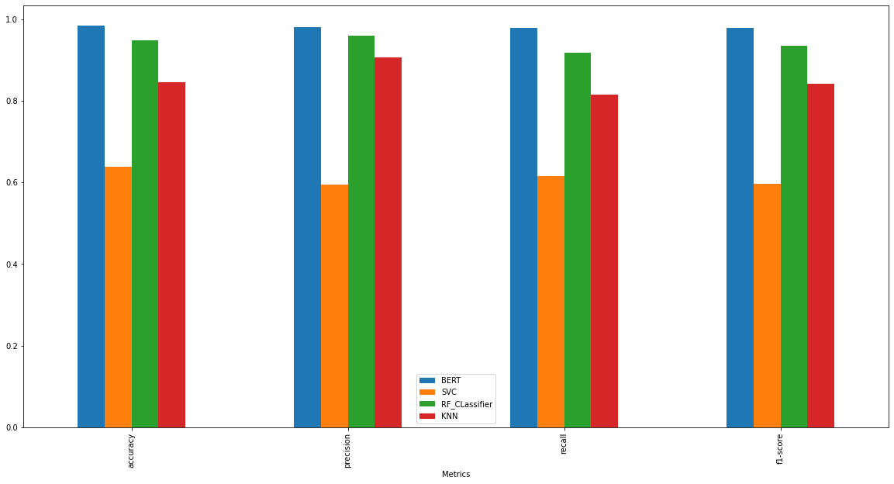
Compare result of trained models
The comparison of accuracy between the models and to show the best performance model
The comparison of all evaluation measure - to accuracy, precision, recall and f1-score

Slide 12
conclusion
In this research, we tried to classify the sentiment in tweets on the topic of bitcoin currency. We got the highest 0.98% testing accuracy by BERT model for the classification of sentiment. The prediction of Bitcoin price in future base on the tweets sentiment can be discovered.

